Slide 1
Seminar for Special Education Teachers – Greece 2020
Implementing good support practices in schools: is practice leadership the answer?
Roy Deveau, Honorary Research Associate,
RMN, RGN, RHV, BA, MSc, MA

Slide 2
UK ID services development: a controlled environment
For around a century UK services for people with intellectual disabilities (and mental health problems) have been largely based in institutions. These institutions - hospitals often had schools attached and children sometimes led segregated lives from birth.
My Colleague Peter McGill has a particular interest in Special Education (in England) and children living in 52 week schools, often far from families.

Slide 3
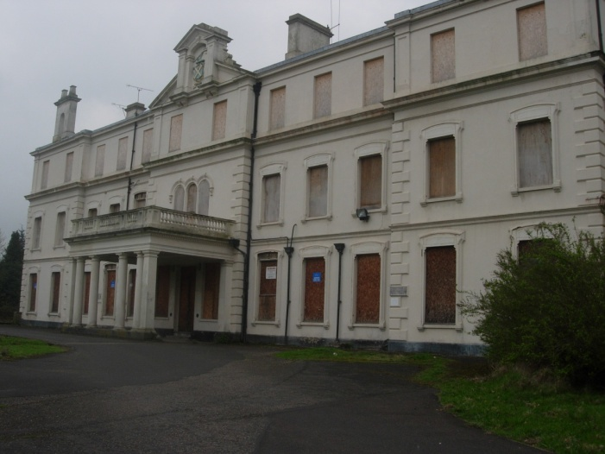
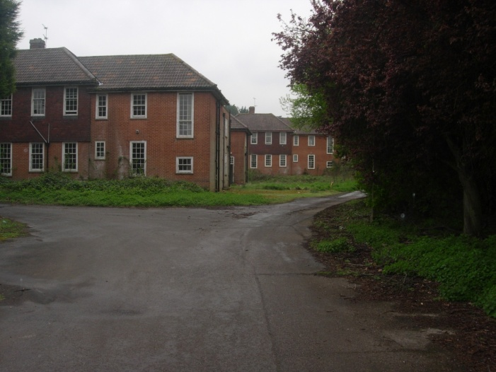
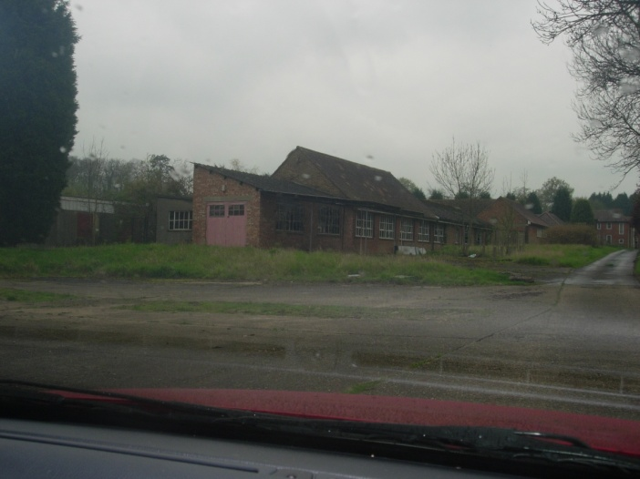
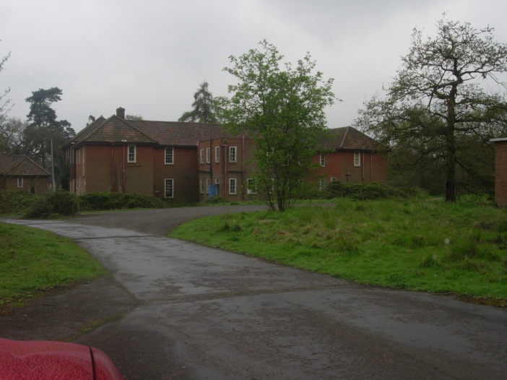
Leybourne Grange (ID) Hospital, Kent (1936-1996)

Slide 4
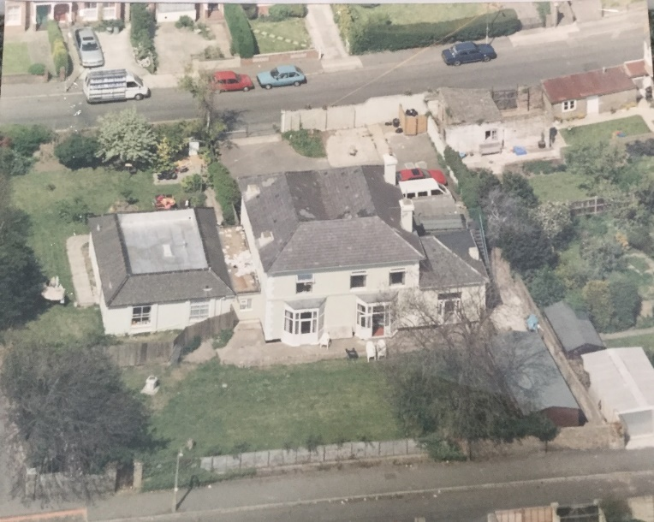
Hospitals to community based homes
Kent, residential care home

Slide 5
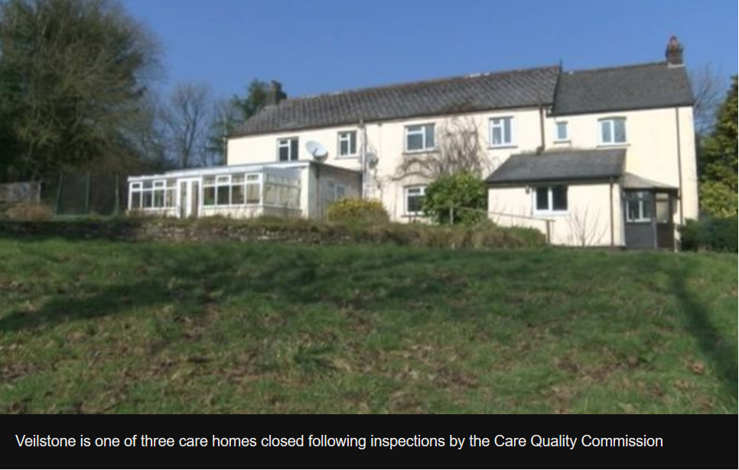
Atlas Project, Devon, Another scandal in small scale community homes

Slide 6
management/leadership experience and research
Repeated failings in leadership and management in ID services.
2005, a literature review; neglect of management /leadership as a research area in ID and social care in the community. Education has always had a strong emphasis upon leadership - National College for School Leadership founded 2000.
One idea was PRACTICE LEADERSHIP associated with Professor Jim Mansell and Tizard Centre.
Quote “Perhaps the most difficult part of the interventions was redefining the role of house managers and patch managers as primarily concerned with “practice leadership” rather than administration” (Mansell et al., 1994, p276)

Slide 7
Current frontline manager research
In general, limited interest has been shown in how managers at all levels impact upon the practices and experiences of frontline staff in ID services.
The research that has been conducted has focused upon the immediate managers working directly to develop and supervise frontline staff. For example:
Competencies required of house supervisors (Hewitt et al., 2004).
Impact of immediate managers (providing practice leadership) upon staff implementation of Active Support (Beadle-Brown et al., 2014; Bigby et al. (2020).
Impact of frontline managers (providing practice leadership) upon staff experiences when working with challenging behaviours (Deveau & McGill, 2016).

Slide 8
My research approaches and results
Survey methods with staff using PL measure (Beadle- Brown, 2006).
Results: practice leadership is associated with a range of better staff experiences e.g. less stress, burnout, better job satisfaction, teamwork and trust in their manager.
Equivocal results for ‘turnover’, practice leaders have high expectations of staff who may well leave when they can’t respond.
Organisational research is looking at wider group of variables associated with motivated able staff e.g. Courage, Compassion, Innovation, Trust. Perhaps in ID? e.g. if facing difficult and emotional rousing and stressful situations TRUST maybe as important as skills and knowledge. It is interesting that PL is quite strongly associated with Trust. So working with staff to develop their practices, engenders Trust.
Result: Win – Win.

Slide 9
My research approaches and results
Qualitative study semi-structured interviews with service managers, analysed using IPA
Results:

Slide 10
Thematic summary
Manager’s knowing what’s going on/ monitoring | Developing new practice and ways of working with service users | Manager’s approach to developing and shaping staff performance | Influence of employing and external organisations | Manager’s personal feelings and values
The importance of personal observation and knowledge for managers | Degree of staff inclusion/ involvement in developing new practice | The importance of personal observation and contact to inform shaping performance | External organisations and negative influences on managers | Managers promoting their value base within the team
Covert/informal versus formal/structured approaches to monitoring | Recognising and using individual staff abilities & observations | Long-term, patient development of staff, but happy to ‘let them go’ if performance will not improve | External organisations and positive influences on managers | Managers working with the constraints and strengths of their own personalities and experiences
Keeping on top of staff performance which can go ‘downhill’ very quickly | Using in-house and external professionals | Using positive/negative feedback | Employers and negative influences on managers | The prime importance of development of self, staff and service users
 | Implementation of new practice requires more formal management processes |  | Employers and positive influences on managers
 | Use of modelling & role play

Slide 11
A framework for thinking about management /leadership in ID (Deveau & McGill, 2016)
Management
Combined in
Leadership
-planning
-setting goals
-monitoring
-controlling
-improving
-doing things right
-efficiency
-budgeting
-coaching-developing others
-networking
-acting as a role model
-creating a climate
-visioning
-strategic thinking
-aligning
-inspiring
-doing the right things
-effectiveness
-opening doors
-building alliances
-removing blocks
Formal Administrative systems
Informal interaction systems
Performance of designated routines & tasks. Paperwork, housework, safety, personal care. Linear relationships expected. Written evidence required.
Emerging activities and relationships are unpredictable. Internalised rules, values and culture reinforce actions. Non linear relationships expected. Observation & testing required
Formal organisational culture
Informal organisational culture
Notes:
This is important ‘what gets measured gets managed’

Slide 12

Example of Active support/PBS

Slide 13
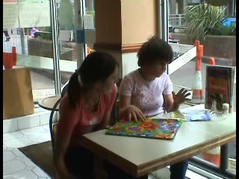
Example of Active support/PBS

Slide 14
My experiences of developing PL in services
Developed EDDY user friendly version of three tier competency training. But staff and manager as practice leaders, not expert led.
Explain;
Demonstrate;
Do under supervision;
You have a go.

Slide 15
References & information
Beadle‐Brown, J., Mansell, J., Ashman, B., Ockenden, J., Iles, R., & Whelton, B. (2014). Practice leadership and active support in residential services for people with intellectual disabilities: an exploratory study. Journal of Intellectual Disability Research, 58(9), 838-850. doi:10.1111/jir.12099
Bigby, C., Bould, E., Iacono, T., Kavanagh, S., & Beadle‐Brown, J. (2020). Factors that predict good Active Support in services for people with intellectual disabilities: A multilevel model. Journal of Applied Research in Intellectual Disabilities, 33(3), 334-344.
Deveau, R., & McGill, P. (2016). Impact of practice leadership management style on staff experience in services for people with intellectual disability and challenging behaviour: A further examination and partial replication. Research in Developmental Disabilities, 56, 160-164.
Hewitt, A.S., Larson, S.A., Lakin, K.C., Sauer, J., O’Neil, S. & Sedlezky, L. (2004) Role and Essential Competencies of the Frontline Supervisors of Direct Support Professionals in Community Services. Mental Retardation, 42 (2), 122-135 doi: 10.1352/0047-6765(2004)42<122:RAECOT>2.0.CO;2.
Mansell, J., Hughes, H. and McGill, P. (1994) Maintaining local residential placements. In Emerson, E., McGill, P. & Mansell, J. (Eds.), Severe Learning Disabilities and Challenging Behaviour: Designing High-Quality Services. London: Chapman and Hall.
Free booklet ‘Practice Leadership’ by United Response available from www.unitedresponse/practiceleadership
Deveau, R. (2015) Practice Paper 3: Practice leadership, Positive Behaviour Support, and reducing restrictive practices available from http://www.bild.org.uk/our-services/positive-behaviour-support/capbs/pbsinformation/
Deveau, R. & Leitch, S. (2018). Person centred restraint reduction: planning and action. (A guide for Practice leaders) BILD publications: Birmingham.

